Slide 1
AGRICULTURE MECHANIZATION 1 bagr 1203
By
KANAABA DEUS

Slide 2
COURSE PERSPECTIVE
Uganda’s agriculture is shifting towards commercialization,
Farmers will need all necessary technologies to ensure the profitability of farming.
Agriculture engineering is one of the disciplines that will enhance agricultural commercialization
Farmers are faced with many engineering constraints in the areas of production, processing and marketing.

Slide 3
JUSTIFICATION
By using improved farm power , irrigation and agro-processing technologies, farm productivity is increased and farmers earn more money from farming.
This unit will empower you with knowledge and skills to use ,select and advice farmers on farm power sources, implements, equipment, irrigation and agro processing technologies.

Slide 4
COURSE BACKGROUND
National perspective
GoU wants to eradicate poverty in the country(current level about 38%).
PEAP (Poverty Eradication Plan) was then created
More than 80% of Ugandans live in rural areas and agriculture is their main source of livelihoods.
To achieve PEAP . Government has to place PMA
Agriculture Research, Agric. Education, NAADS & agro-processing are one of the seven pillars of PMA.
Universities had to adjust themselves to respond to the PMA program

Slide 5
COURSE OBJECTIVES
By the end of this unit, you will be able to;
Apply use of simple mechanics in different agriculture activities
Demonstrate how to care for farm tools, equipment and farm machinery
Acquire knowledge and skills required for cost-effective use of farm labor, machinery, irrigation and agro-processing techniques.
Acquire knowledge and skills to provide advice to farmers on selection and use of power sources on farm, machinery, irrigation and agro-processing techniques.
Be acquainted with the National development policy and the country’s direction towards mechanization

Slide 6
What is Agricultural Mechanization
Study of the manufacture, utilization, distribution, repair and maintenance of all machines involving farming operations from land clearing to processing.
Use of farm machinery

Slide 7
SIMPLE MACHANICS
A machine; is a device which allows the supply of energy at one point to do work at another point

Slide 8
AGRICULTURE MECHANIZATION
Mechanization entails the use of farm machinery and facilities to maximize all farm inputs for optimum production.
To mechanize there is need to take note of the following:
There must be a suitable equipment developed for timely production of goods.
manufacturing and availability of machine spare parts must be adequate to meet needs of end users of such machinery.
Maintenance of such machinery is essential for productivity and enhanced profit making.

Slide 9
Cont’n
Effective utilization of the machinery (operators and technical staff must be available).
Favorable condition of use such as government policy, political frame work, financial obligation and seasoned professionals to handle vital aspect of mechanization are essential.

Slide 10
AIMS OF AGRICULTURE MECHANIZATION
To remove farm drudgery
To improve on product quality
To reduce cost of labour
To increase income
Provision of employment opportunities
Improve livelihood of farmers
It helps to increase agriculture out put by increasing the amount land under cultivation.
It helps farmers to do jobs which would be impossible to do by hand e.g. uprooting big trees, ploughing in dry weather etc.
Releases human labour to be used in farm operations that cannot be mechanized
It ensures timely farm operations, e.g. quick seed bed preparation leads to early planting and harvesting

Slide 11
It discourages land fragmentation which is uneconomical for mechanization.
Eases problem of labour shortage during farm work since one machine can do work for many people.
It is faster hence saves time for other job on the farm.
It helps to reduce human drudgery by enabling farmers to do difficult and unpleasant jobs more easily hence making agriculture dignified and attractive profession.
Allows better combination of enterprises through saving time for different operation.
Encourages proper planning and management of the farm

Slide 12
Demerits of Mechanization
Increases an individuals workload
Can be hazardous to health
Reduces social interaction associated with farm work
Possession of small scattered plots of which make it uneconomical to mechanize
Lack of adequate capital to invest in machinery.
Insufficient work on the farm: Machines tend to lie idle for most part of the year when there is no work on the farm and this makes them depreciate faster .e.g after harvesting the combined harvester will lie idle until the next harvesting season.
Lack of suitable machines: Most agricultural machinery are imported and are not adapted to the tropical conditions.
Presence of cheap alternative sources of power: There is always free/cheap human labor from family members; therefore many farmers would not go for machines.
.

Slide 13
Cont’n
Nature of the crops grown: The agronomic practices involved in the production of some crops cannot be mechanized. For example harvesting of coffee, bananas, pineapples, mangoes and cabbages. picking is not easily mechanized
Topography in some areas: Some areas are too steep and mechanization cannot work properly.
Conservative behavior of some farmers: Some farmers are adamant to change their traditional beliefs and values .They can only change their life styles if the new technologies are within the range of their aspirations and expectations.
Reduced job opportunity for the masses which leads to unemployment.
Encourages quick farming which compromises careful farming leading to poor yields.
The thick vegetation hinders the use of machines especially the ploughs.
Lack of enough demonstration centers where machines are tested before adoption.
Ineffective mechanization policy or strategy.
It may lead to over production which eventually leads to lowering of market prices.
Scarcity of skilled manpower: There are few people who can operate and maintain machinery.
Accelerated land degradation. Clearing large pieces of land by machines exposes soil to effects of rain water and thus soil erosion

Slide 14
LEVELS OF MECHANIZATION
LEVEL 1 Human
Power rating(0.1 HP),
most primitive
Highly inefficient
High energy consumption
Low cultivated area
LEVEL 2 Animal
Power rating(1-5 HP)
Better than manual/human
Larger capacity for animal drawn tools
Prone to Tsetse fly infestation
Competition for meat/milk by humans
LEVEL 3 Mechanical
Power rating(10-200HP)
More coverage of land
Highly efficient
High productivity
Expensive
Needs skilled labour

Slide 15
Other sources of Power
Solar
From the sun (continuous, 3.41X10⁶ Joules/m²
Useful for: space heating, water heating and crop drying
Wind
Used with wind vanes and usually productive for light farm operations like winnowing however cannot be available when needed
Biogas/Bio energy
Renewable source of energy
Hydro power
- obtained from water falling from a high level to a lower level
QN. Differentiate between the terms power and energy as used in farm mechanization

Slide 16
THE TRACTOR
Tractors can be classified in terms of their capacity (power rating) and type (wheel, crawler etc).
Wheel type can be of two types namely Two-wheeled and four-wheeled.
Others include: earth moving types and industrial types.
Power rating ranges from 1.3 to 150 HP

Slide 17
Selection of farm tractors
To select appropriate size of farm tractors, the following must be considered.
Farm area to be cultivated
Type of crops to grow
Soil structure
Financial capability
Size of implement to be driven

Slide 18
TRACTOR AS A PRIME MOVER/VERSATILE EQUIPMENT
Drives all other farm machinery
PTO for energy generation
Provision of Draft power for tillage tools through 3-hitch system
Used for trailing and transportation of farm produce
Hydraulic output for equipment lifting

Slide 19
Internal Combustion Engines
Burns fuel internally
Mixture of fuel and air
Power generated by the explosion of burnt mixture of fuel and air
Common types Include:
Gasoline/Otto cycle
Diesel Engine

Slide 20
Engine parts
Stationary parts
Engine block
Cylinders
Cylinder head
Crankcase
Sump
Rotating parts
Crankshaft
Main bearings
Flywheel
Camshaft
Reciprocating parts
Piston
Connecting rods
Valves
Valve seats
Engine Accessories
Electrical system
Cooling system

Slide 21
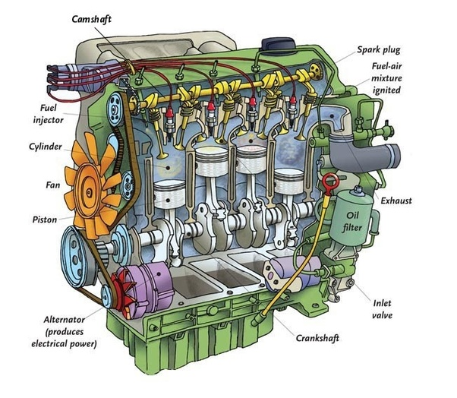
THE ENGINE BLOCK

Slide 22
WORKING PRINCIPLE OF I.C. ENGINE/ FOUR STROKE CYCLE ENGINE / TWO STROKE CYCLE ENGINE
A mixture of fuel with correct amount of air is exploded in an engine cylinder which is closed at one end.
As a result of this explosion, heat is released and this heat causes the pressure of the burning gases to increase. This pressure forces a close fitting piston to move down the cylinder. The movement of piston is transmitted to a crankshaft by a connecting rod so that the crankshaft rotates and turns a flywheel connected to it.
Power is taken from the rotating crank shaft to do mechanical work. To obtain continuous rotation of the crankshaft the explosion has to be repeated continuously

Slide 23
Before the explosion to take place, the used gases are expelled from the cylinder.
Fresh charge of fuel and air are admitted in to the cylinder and the piston moved back to its starting position.
The sequences of events taking place in an engine is called the working cycle of the engine.

Slide 24
FOUR STROKE CYCLE ENGINE ( DIESEL/ PETROL ENGINE)
In four stroke cycle engines the four events namely suction, compression, power and exhaust take place inside the engine cylinder.
The four events are completed in four strokes of the piston (two revolutions of the crank shaft). This engine has got valves for controlling the inlet of charge and outlet of exhaust gases.
The opening and closing of the valve is controlled by cams, fitted on camshaft. The camshaft is driven by crankshaft with the help of suitable gears or chains. The camshaft runs at half the speed of the crankshaft. The events taking place in I.C. engine are as follows

Slide 25
FOUR STROKE CYCLE
1. Suction/Inlet stroke
2. Compression stroke
3. Power stroke
4. Exhaust/outlet stroke

Slide 26
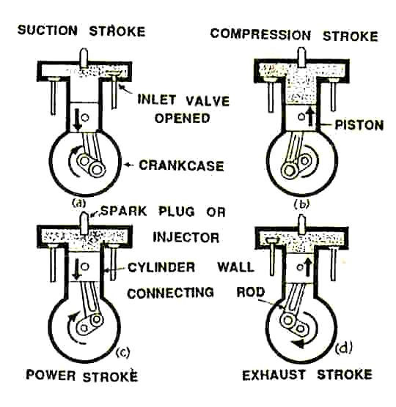
Summary of the cycle

Slide 27
Suction stroke
During suction stroke inlet valve opens and the piston moves downward.
Only air or a mixture of air and fuel are drawn inside the cylinder.
The exhaust valve remains in closed position during this stroke.
The pressure in the engine cylinder is less than atmospheric pressure during this stroke

Slide 28
Compression stroke
During this stroke the piston moves upward.
Both valves are in closed position.
The charge taken in the cylinder is compressed by the upward movement of piston.
If only air is compressed, as in case of diesel engine, diesel is injected at the end of the compression stroke and ignition of fuel takes place due to high pressure and temperature of the compressed air.
If a mixture of air and fuel is compressed in the cylinder, as in case of petrol engine, the mixture is ignited by a spark plug.

Slide 29
Power stroke
After ignition of fuel, tremendous amount of heat is generated, causing very high pressure in the cylinder which pushes the piston downward
The downward movement of the piston at this instant is called power stroke.
The connecting rod transmits the power from piston to the crank shaft and crank shaft rotates.
Mechanical work can be taped at the rotating crank shaft. Both valves remain closed during power stroke.

Slide 30
Exhaust stroke
During this stroke piston moves upward.
Exhaust valve opens and exhaust gases go out through exhaust valves opening. All the burnt gases go out of the engine and the cylinder becomes ready to receive the fresh charge.
During this stroke inlet valve remains closed .Thus it is found that out of four strokes, there is only one power stroke and three idle strokes in four stroke cycle engine.
The power stroke supplies necessary momentum for useful work.

Slide 31
DAILY CARE OF TRACTOR
Check the Cooling System.
Remove the radiator cap and check the level of the coolant
If the level is below 5cm firm the neck of the radiator refill the radiators to about 5cm of the radiator neck.
Check for leaks about radiator, radiator hoses and hose clamps
Remove trash collected on front of radiator screen
Check the crankcase oil level
Check oil level position- don’t’ check the oil level while the tractors is running.
Add oil it needed: it is extremely important that you use a clean container and clean oil if you want the tractors to continue to give good service.
Check the Battery
Check to see the cables use firmly connected to the terminate
Check the electrolyte level of each cell-add distilled water if necessary.
Check for corrosion on the battery terminals: clean if necessary.
Check the hold down clap, clamp firm it lose.

Slide 32
CONT’N
Check the Tyres:
Check the tyres for the right pressure recommended by the manufacturers.
Check side walls for cuts or breaks
Check treads for nails, stones etc.
Check fuel level: Add if necessary
Check the fuel system
Check hose for leaks
For diesel fuel system, check for drain cock on:
Bottom of fuel tank
Bottom of fuel filter

Slide 33
6. Lubricant with grease is not daily job but carry it out as regularly as recommended by the manufacturer.
7. Make sure your cloths are free from tears bulging pockets, flayed edges and heavy cuts. Also wear shoes with heels and tight soles.
8. Check miscellaneous items: water for loose nuts bents brachets that need straightening worm parts that need replacing, loose or worn fan belts loose wheel etc. starting a Diesel type engine:

Slide 34
The following steps should be followed while starting the
diesel engine:
Checks to see that gear shift lever is in neutral
Turn on fuel supply at fuel stop control but don’t open throttle.
Turn starter switch to on position
Depress clutch to ease starting load
Crank engine
Adjust throttle to moderately fast drilling speed

Slide 35
CONT’N
With the clutch still disengaged, move shifting leves into gear position that fits speed and power desired.
Check to make certain level have no riders and that all persons, livestock and obstructions are out of the way.
Increase engine speed slightly and gradually engage clutch –gradually open throttle to desired speed.
Disengage the clutch every time you change the gear.

Slide 36
CONT’N
Check oil pressure gage or warning light
Check ammeter or warning light to see if battery is charging.
After one or two minutes adjust to higher drilling speed.
Reduce engine speed to a slow idle.
Check toot brakes and unlatch if in latched position

Slide 37
TRACTOR OPERATION; Safety Procedures:
If you acquired a new tractor, keep it on light work for the first 25 -48hours. Avoid labouring the engine.
Don’t operate the independent foot-brake when traveling at high speed.
Don’t run on the highway without locking the foot-break pedals together.
Don’t wear-loose clothing near moving parts of a tractor engine or implements.
Don’t attempt to start the engine in gear.
Do not run the P.T.O. or Belt pulley (if any) without a guard.
Do not leave the starts key in the tractors unattended.

Slide 38
CONT’N
Do not use the differential lock on the public highway
Do not make a sharp turn unless the differential lock is out of engagement.
Do not operate the tractor on dangerous steep ground.
Be cautions on steep slopes, realizing that the sudden swing of a heavy implement, or the pull of a tractor can cause trouble. Use clutch brakes, throttle and steering cautiously.
Do not carry passengers on the tractors or linkages.
Do not turn with a projecting implement without making sure there is enough room for it.
Do not hitch trailed implements above the centre line of the rear-axle.

Slide 39
Attributes of a Good Tractor Operator
A good driver
Keeps his tractor clean.
Complete the daily service at close of work.
Enters up the work book daily at close of work
Check oil pressure and ammeters when starting the engines
Listen for any unusual noise from the engine
Reports immediately any defects, he cannot correct himself.
Does not allow anyone to ride on his tractor with implement.
Does not pull anything by the Top link.
Does not wear long loose clothing
Keep this fuel and containers clean.
Allows no light or smoking near the tractors when refueling.
Know the correct hours to change engine oils filters etc.

Slide 40
CONT’N
Know when to service the air cleaner
Uses the right grade of oil for this services.
Keep the tyres at correct pressure.
Do not allow unauthorized person to make adjustment on the tractor
Does not touch the diesel at injection pump in the injectors
Keep space filters, fan belts and hoses.
Obeys the high way code at all times
Takes pride in his work.

Slide 41
IMPLEMENT MAINTANANCE
The tractor driver is responsible for opening implements or machine which he used with or tractor..
The oil level in gear boxes of P.T.O or pulley drives replacement or machine should be checked twice daily.
All nuts and bolts should be checks for tightens twice daily.
All tyre pressure should be checked daily
Adjustment of rubber belts or P.T.O drivers implements should be checked daily.
The hoses and nozzles of sprayer must be checked frequently when in use for leaks or blockages

Slide 42
.
Regular Maintenance of a Tractor
Faculty Exhaust Excessive noise causing in-convenience/fatigue for operator.
Incorrect air filters maintenance: allow dust particle to enters engine, accelerating wear with engine component e.g. piston rings, lines, which causes excessive oil consumption and drop in engine power.
A blocked air filters will reduce engine power
Engine cooling system: A block radiator (externally or internally) will accuse engine to over heat with consequential reduction or power and possibly, damage to engine components. The radiators cap prevents entry of dirt and helps maintain correct operating temperature.
Dirt or water in fuel system due to impure fuel missing fuel tank cap, improper filter maintenance causes rapid wear (damage to fuel pumps and injectors which results in erratic engine flashing/ running.
Engine Maintenance: Regular renewal of oil and filter is essential to avoid premature wear of internal components

Slide 43
Farm Machinery Management
A farms economic success is largely determined by proper management of the farm fields machines.
Machinery management implies a thorough knowledge of the following
Mechanical principles and limitation of the machine
Efficient operations in the field
Appropriate machine maintenance
Timely repair and replacement
Selection of a machine system
Economic analysis of actual or proposed management activities

Slide 44
Equipment Selection
Implement performance
Timeliness
Power availability
Labour
Machinery Selection
Performance Characteristics
Costs
Operation

Slide 45
SYSTEMS OF TRACTOR ENGINES
The major systems include;
Air supply system
Cooling system
Fuel supply system
Lubrication system
Electric system
Transmission system

Slide 46
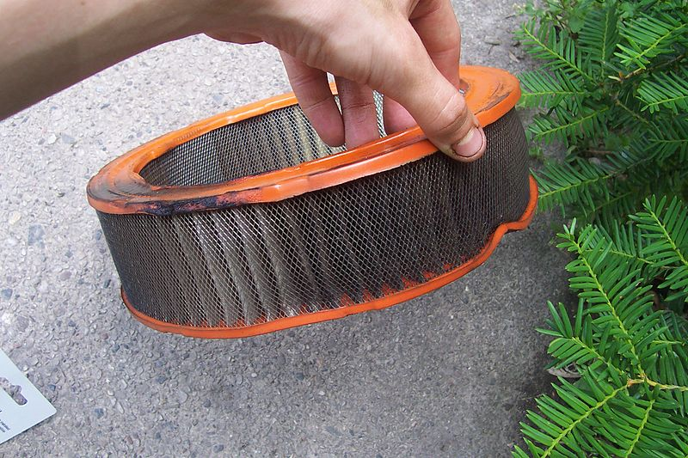
Air supply system
An engine requires a regular supply of clean air (oxygen) for burning the fuel. Air from the atmosphere is cleaned and purified by the air cleaner before its allowed into the engine. If it is not cleaned, dust and other foreign impurities would mix with the fuel and damage the engine.
The air cleaner
There are two types of air cleaners; namely;
The wet (oil bath) air cleaner - only new oil is needed during servicing
The dry air cleaner
.

Slide 47
Assignment: Draw a well labeled diagram of the oil bath air cleaner (wet type)
Mechanism of operation
The dirt laden (heavy) air enters the pre cleaner where it meets the vanes that cause swirling.
The swirling helps to throw out the dust particles such as leaves, straw, insects and other big particles.
Air then passes rapidly down the stack/ central pipe to the oil bowl/cup/canister container carrying the lighter dirt

Slide 48
As the air bubbles through the oil in the cup, much of the lighter dirt gets stuck in the oil bath.
From the oil bath, air passes through the wire gauze (filter element) which traps any dirt that may have escaped the oil bath
Apart from the cleaning effect, the filter element dries the air and prevents any oil from reaching the engine.
Finally, clean air goes through the outlet to the engine cylinders

Slide 49
Care and service of the oil bath air cleaner
Under normal working conditions the oil bath cleaner should be checked weekly.
If there is more than ¹/₂ cm of dust in the oil bath then it should be cleaned out and refilled with fresh clean oil.
If a tractor is working in very dirty or dusty conditions then the oil bath should be checked daily for the thickness of dirt.
Periodically the wire mesh should be thoroughly washed in paraffin to remove trapped dirt.
Use the recommended type of oil for the bath that is able to trap dirt
After drying, it should be dipped in clean oil and drained to leave a thin film adhering to the wire mesh to collect more dirt

Slide 50
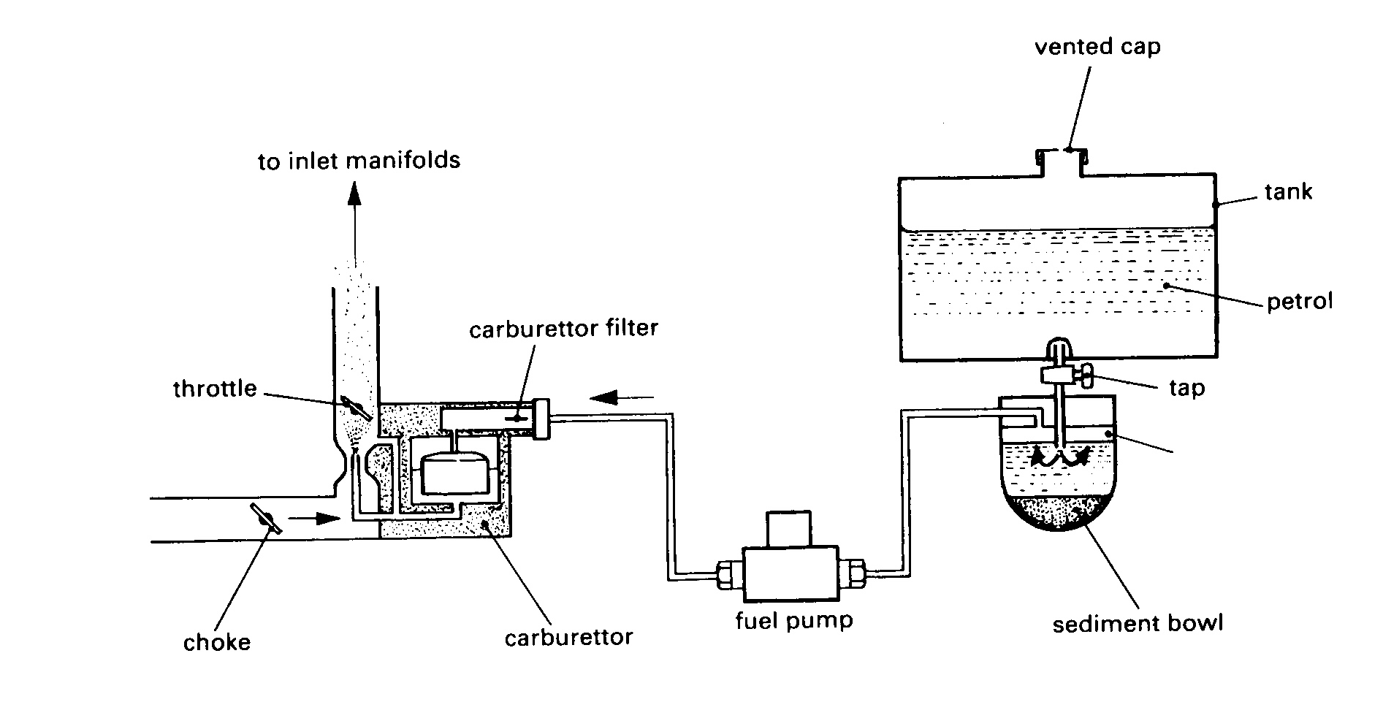
Fuel system in a petrol engine
This consists of the fuel tank, through sediment bowl, fuel pump, fuel filters, carburetor and connecting lines (pipes).

Slide 51
How the fuel system of a petrol engine works
Petrol fuel flows by gravity through the connecting lines from the tank to the sediment bowl where large particles are removed from the fuel.
It then flows to the fuel filters where small dust particles are removed and then goes to the fuel lift pump.
The lift pump pumps the fuel to the carburetor, where it is mixed with clean air from the air cleaner.
Air –fuel is mixed and metered in the carburetor, then flows to the cylinders during the induction stroke.

Slide 52
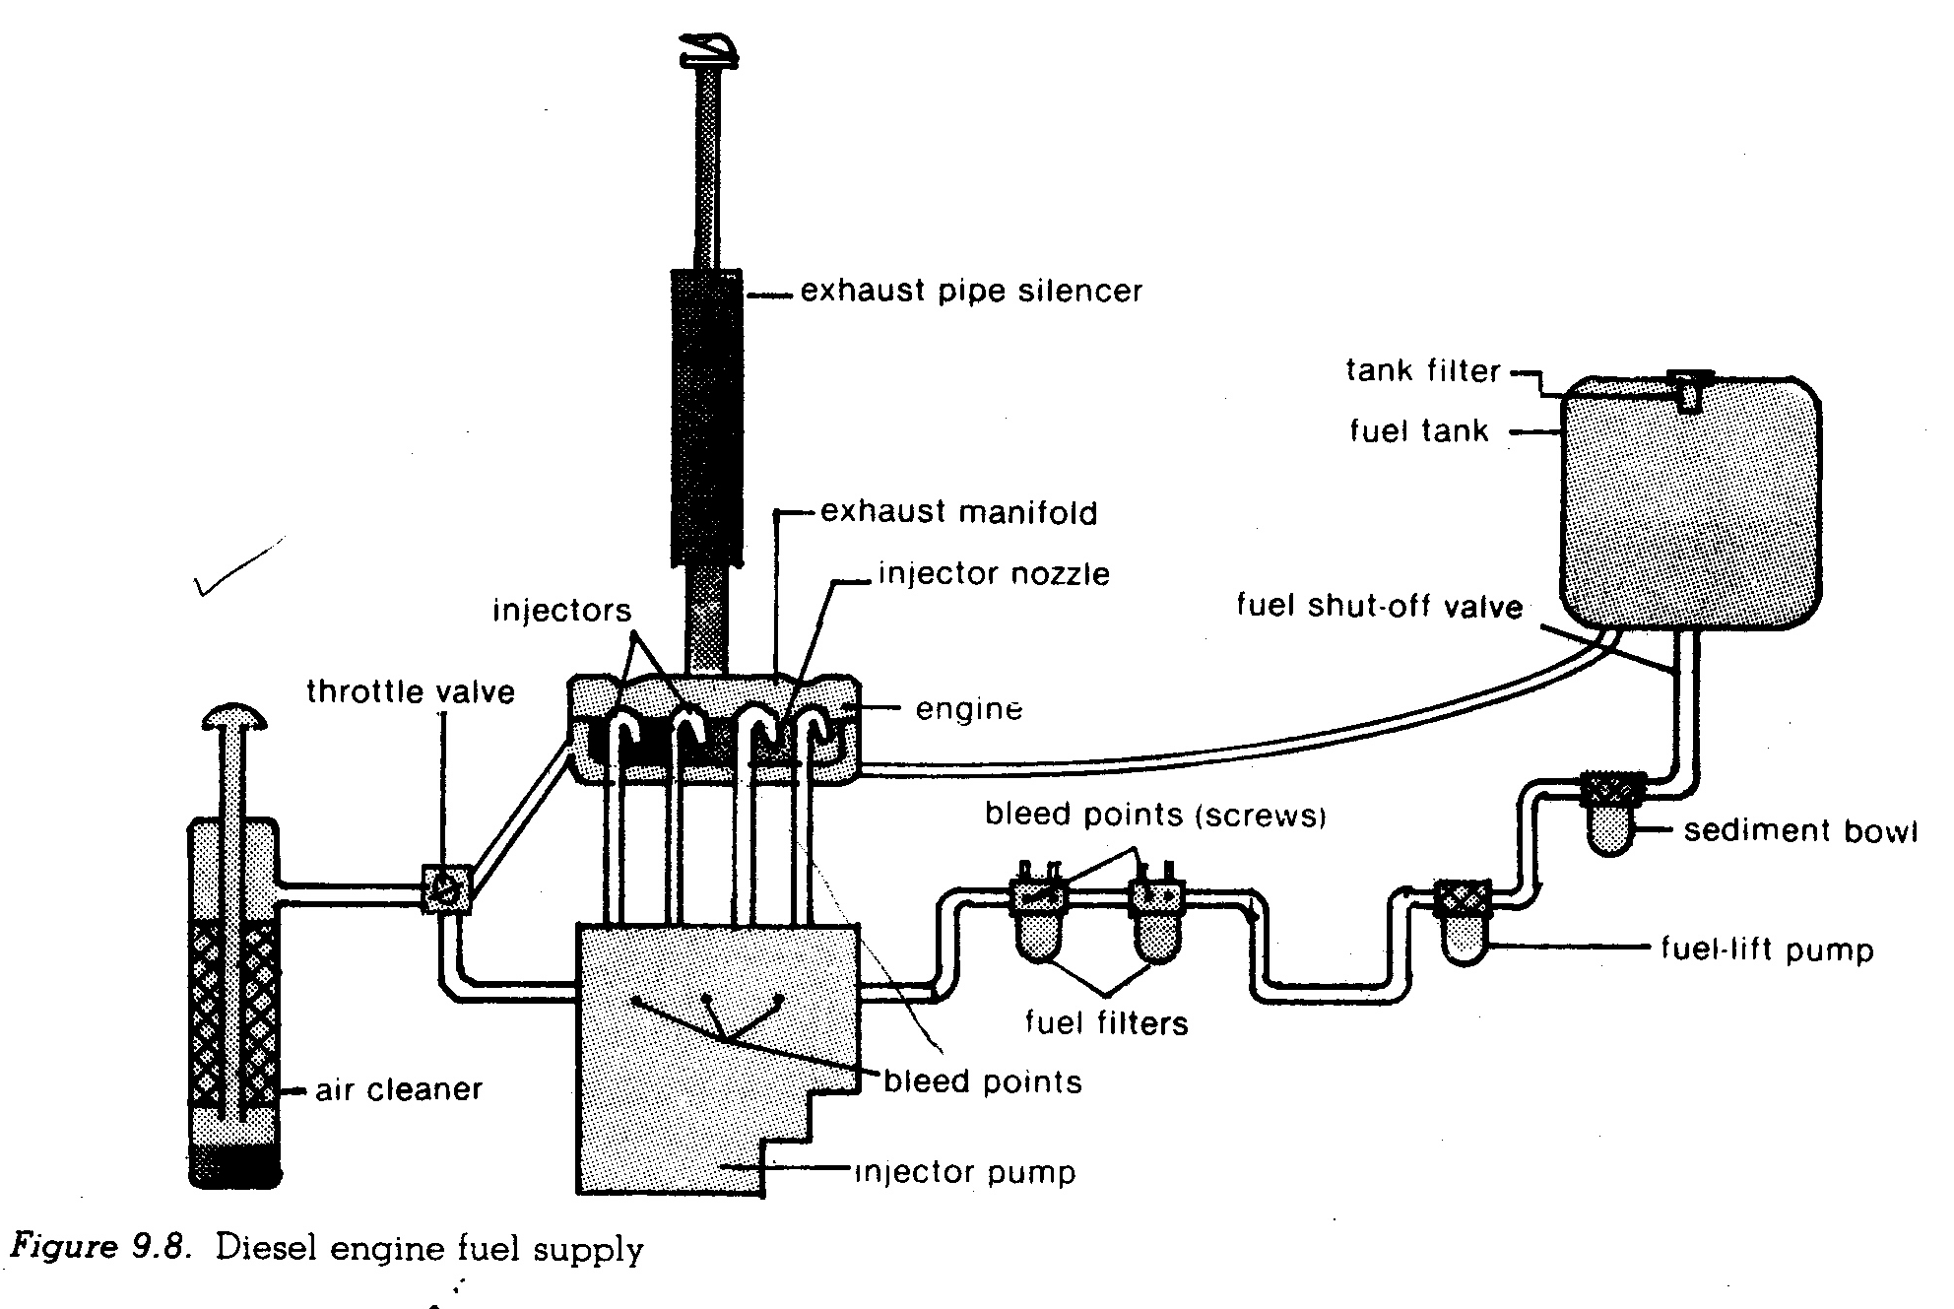
FUEL SYSTEM OF A DIESEL ENGINE

Slide 53
How the fuel system of a diesel engine works
When the engine is running, diesel fuel flows through the supply pipes from the tank to the sediment bowl and then to the fuel lift pump. The lift pump forces the fuel through the fuel filters to an injector pump, where it is subjected to very high pressure and sent to the injectors. The injectors atomize fuel and then inject it into the cylinders (combustion chambers) at the end of the compression stroke

Slide 54
; Maintenance of fuel systems
Fuel Filters need regular replacement for every service as per the manufacture’s recommendations.
The sediment bowl should be cleaned regularly to remove dirt
Bleed the system to get rid of trapped air /air lock for diesel engines
Ensure that the fuel tank cap is tightly placed to avoid spillage of fuel
Tighten the pipes of injector and fuel delivery tube to reduce fuel loss
Use the correct type of fuel for the engine always
Always use clean fuel from a reliable source so that the system is not blocked
Seal off all the leakages in the system to reduce fuel loss
The injector pump or carburetor should be cleaned regularly by removing dirt

Slide 55
LUBRICATION SYSTEM
Is a system that reduces friction as well as wear and tear of rubbing parts.
The lubrication system in petrol and diesel engines is the same and consists of the sump, oil filter, oil pump and the oil ways (gallery)
LUBRICANTS
A lubricant is a substance that reduces friction between two moving surfaces in machinery. Examples of lubricants are oil and grease
General functions of lubricants in farm machinery
Reduce friction by establishing a film of lubricating oil between the moving parts.
It acts as a cleaning/ flushing agent i.e. washes off all dirt, soot and dust from metal surfaces.
It acts as a sealing agent i.e. seals the piston rings and cylinder walls preventing loss of compression.
It acts as hydraulic fluid.
It’s a cooling agent i.e. carries away heat from working surfaces.
Prevents rusting of metals.
Reduces noise as engine parts move against each other.
Lubricants act as shock absorbers i.e. they absorb shocks that would occur on the bearings.

Slide 56
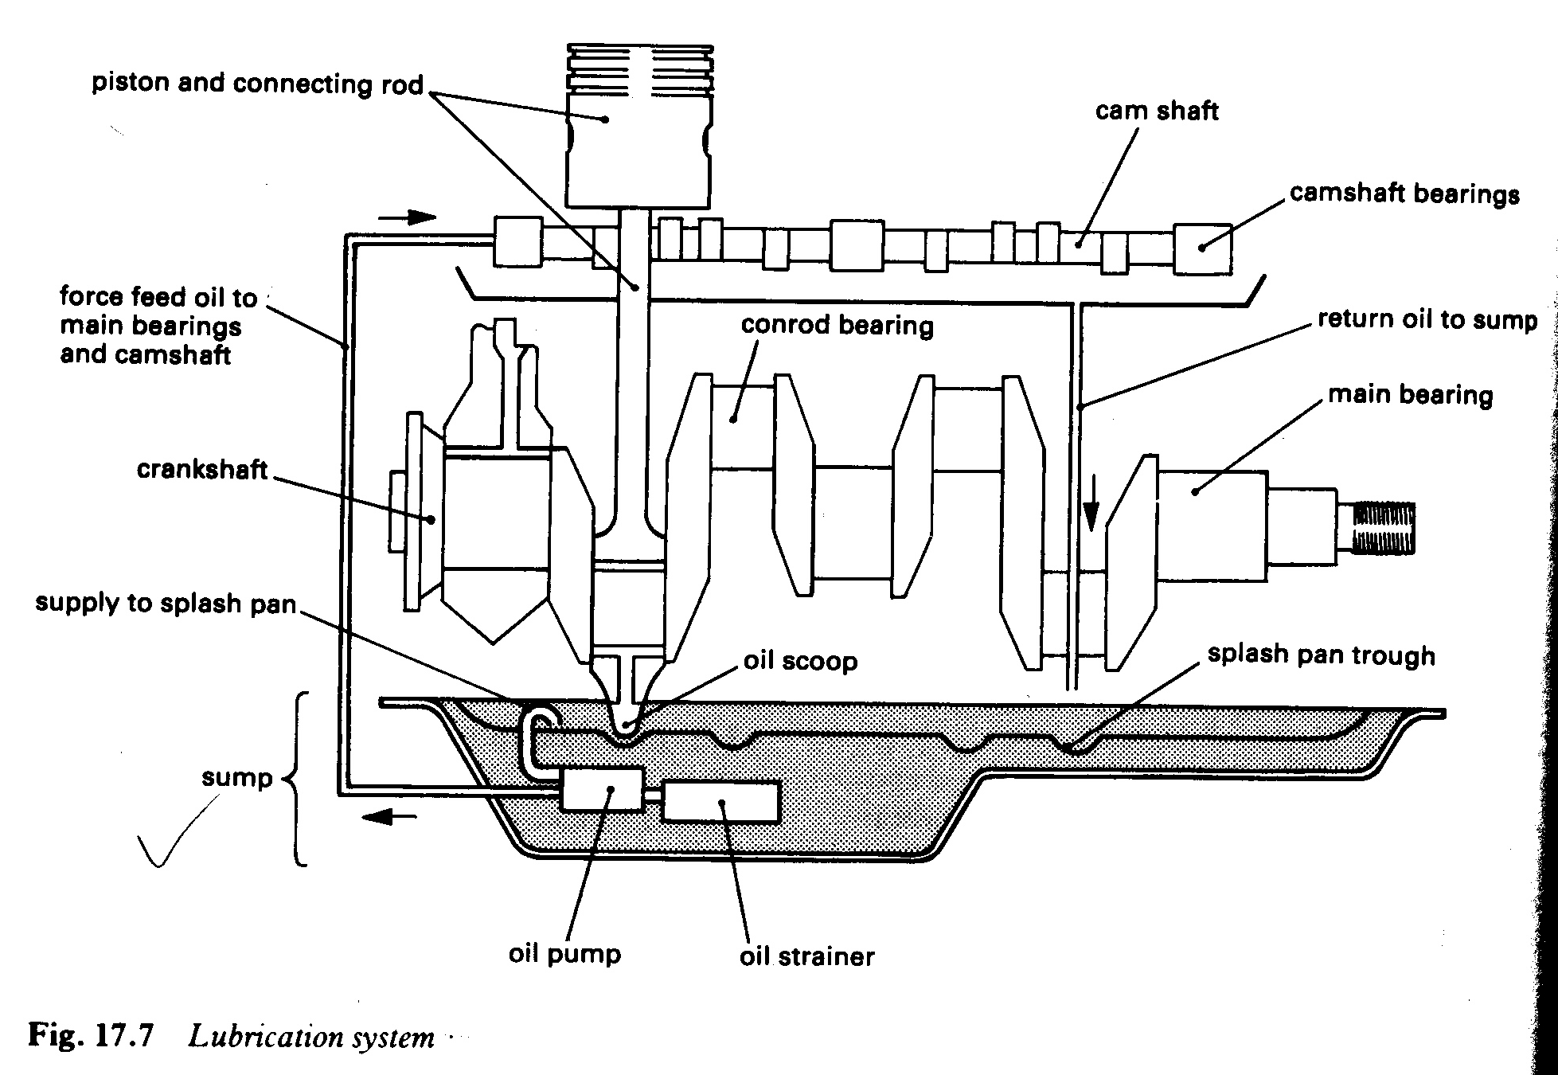
TYPES OF LUBRICATION SYSTEM
Splash feed lubrication
Pressure/ force feed lubrication
Petrol (oil mist) lubrication
Force feed lubrication system

Slide 57
Working mechanism of a force feed lubrication system
Most modern tractors use the system and the main components include oil pump, oil filter, oil strainer and oil ways.
Lubricating oil which is stored in the oil sump is drawn by the oil pump, forces it through the strainer (filter) and then pumped to the oil lines and drilled oil ways around the cylinder block, pistons, connecting rods, camshaft, crankshaft, values and bearings.
It circulates around the engine through the oil ways under pressure maintained by the oil pump that derives power from the camshaft
After circulating around the engine, it drips back into the sump from where it is recycled.
Continuous circulation makes the oil dirty reduces in volume. This can be checked using a dip stick that is inserted in the oil sump

Slide 58
THE COOLING SYSTEM
This system gets rid off excess heat produced in the engine. A lot of heat is produced in a tractor when fuel is burnt to be turned into a useful work. Most is passed out with exhaust gasses and the remaining is reduced by the cooling system.
Importance of the cooling system
It removes excess heat thus preventing over heating of the engine.
Reduces damage to the engine i.e. engine cracking.
It controls the temperature of the engine within specific range for its proper operation.

Slide 59
CAUSES OF OVERHEATING IN ENGINES
Use of dirty water
Leaking radiators
Leaking water pump
Choked or leaking hose pipe
Leaking head tank
Loose fun belt which fails to blow air for cooling water
Chocked radiator fins
Rusty water jackets
Defective thermostat
Low engine oil level
Choked air cleaner

Slide 60
TYPES OF COOLING SYSTEMS
There are two types of cooling systems.
Air cooling system - use air as a coolant
Water cooling system - use water as a coolant
Components and their functions
Radiator: Cools water from the water jacket by convection currents. The tubes in the radiator increase the surface area for cooling.
Water jackets: This is the area around engine cylinders in which the water circulates. It’s connected to the radiator through the bottom and top hoses.
Water pump: Pumps cool water from the bottom tank to the engine cylinders
Fan: Blows cool air on to the radiator fins to facilitate rapid cooling of hot water.
Thermostat: It’s an automatic device which regulates engine temperature by controlling circulation of water in the water jackets. When the engine is cold, thermostat valve closes and prevents the circulation of water so that the engine can warm up.
Temperature gauge: It indicates to the driver engine temperature so as to avoid overheating of the engine.
Fins: They increase the surface area for cooling of water in the radiator

Slide 61
How the water cooling system works
When the engine is switched on, heat is produced in the cylinders and is transferred to the water in the jackets surrounding them. When the temperature of water rises up to about 70⁰C, the thermostat valve opens and water flows into the radiator header tank. It is then replaced by cool water from the bottom of the radiator. The movement of water is facilitated by an impeller (pump).As the heated water flows through the radiator tubes; it gives off the heat to the air being blown through the grill of the radiator by a fan.

Slide 62
ELECTRICAL SYSTEM / IGNITION SYSTEM
The main function of the electrical system is to provide the spark which burns the fuel-air mixture in petrol engines. The system consists of 4 circuit units that operate independently, but all rely on the battery as a source of electricity. The circuits are
Starter motor circuit: It consists of the starter motor whose prime function is to start the engine by turning the fly wheel mechanically.
Ignition circuit: For igniting fuel-air mixture at the end of every compression stroke in petrol engines. But for diesel engines the ignition of fuel occurs when it is released into the hot compressed air by the injectors. The ignition circuit consists of, switch, distributor, contact breaker points and condenser.
Lighting circuit: For lighting head lamps, parking lights, meters on the dashboard and brake lights.
Dynamo or generator circuit: For recharging the battery and can also be used for lighting.

Slide 63
Ignition system of a petrol engine

Slide 64
Parts of the battery ignition system and their functions
Part | Function
Battery | Stores electricity in chemical form. Supplies electric current to the induction coil.
Ignition switch | Completes the primary circuit when switched on so that current can flow from battery to the induction coil
Induction /ignition coil | Induces a high voltage in the secondary winding after the current in the primary winding is interrupted.
Contact breaker point | Interrupts the flow of current to the coil at desired time. It is operated by the camshaft.

Slide 65
Cont’n
Distributor | Distributes the high voltage current to each sparkplug at correct time
Sparkplug | Possesses a gap between its terminals across which a spark that ignites the fuel-air mixture is produced.
Voltage control box / cut out | Disconnects the battery from the generator so that it does not discharge to the generator when the engine ia off or running at a low speed.
condenser | Stores electric current briefly before passing it on to the distributor. Protects the contact breaker point from arcing.
Starter motor | Uses electricity from the battery to rotate the fly wheel so that the engine can start.
Dynamo/generator | Generates electricity for recharging the battery

Slide 66
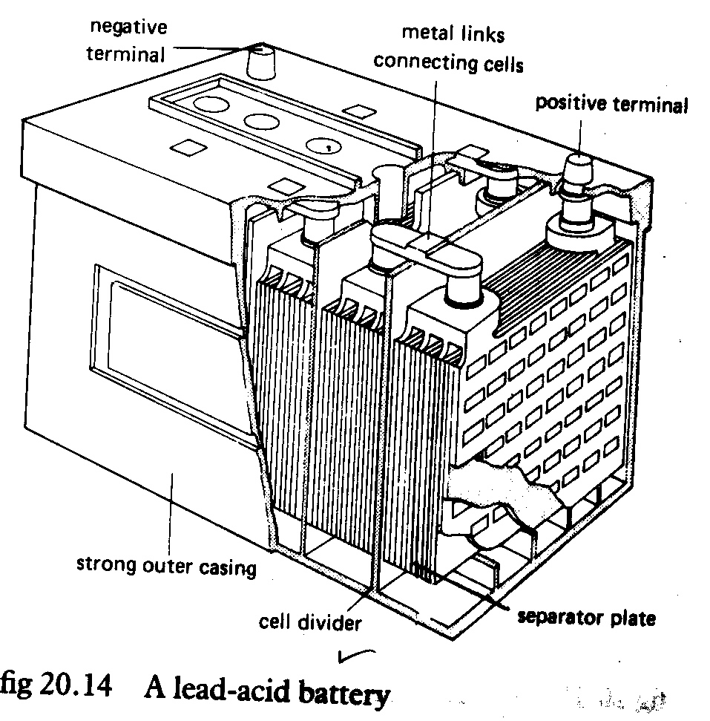
The Battery

Slide 67
Care and maintenance of the battery
Check the level of electrolyte if it is low add distilled H₂O up to required level.
Ensure that the battery is firmly secure (fixed) onto the tractor to prevent falling off due to the engine vibrations.
Keep the casing and terminals of the battery clean and smear with grease to prevent corrosion.
Keep the vent holes free from blockage allow easy escape of gases formed during charging and discharging action.
Empty the battery and Keep it up side down when not to be used for a long time.
Place the battery on a piece of wood especially if it is not to be used for some time. A battery loses its power when left on bare ground.
Keep the battery fully charged by ensuring that the fan belt which drives the generator is at the correct tension and in good condition.
Frequently check the specific gravity of electrolyte using a hydrometer and add more sulphuric acid if the S.G is below 1.25
The terminals should be correctly connected to the tractor

Slide 68
How the coil ignition system of a petrol engine works
This system consists of two circuits, namely the primary and the secondary circuits.
The primary circuit (low tension circuit) consists of the battery, ignition switch, primary coil winding, breaker mechanism and condenser.
The secondary circuit (high tension circuit) is made up of the secondary coil winding, distributor and spark plugs.
The two circuits work together to produce sparks for igniting fuel-air mixture in petrol engines.
When the ignition switch is turned on the primary circuit is completed and a low voltage current flows in the primary circuit.
As the current from the battery flows through the primary windings of the induction coil a magnetic field is created around the secondary winding.
At the same time current from the battery flows to the starter motor which turns to the crankshaft.

Slide 69
When the contact breaker points are opened (interrupted) the magnetic field around the secondary winding of the coil collapses.
This induces a high voltage in the secondary winding which then flows to the rotor arm in the distributor head.
As the rotor arm rotates, it touches the contact points which are connected to the spark plugs and high voltage current flows to the spark plugs.
As the current jumps across the gap between the electrodes of the spark plug, a spark that ignites the fuel ₋ air mixture is produced.
This forces the piston downward and sets the engine running subsequently.
The rotating crankshaft causes the camshaft to turn and operate the contact breaker points.
The opening and closing of the contact breaker points creates an intermittent (on and off) current in the primary circuit.

Slide 70
Maintenance of the electrical system
Keep all the terminals and connections clean and tight
Drive belt for the generator should be maintained at the correct tension
The contact breaker points should be serviced every 200 hours
Spark plugs and the distributor points should be kept clean ensure the spark plug gaps are kept at the recommended value (0.6mm).A feeler gauge is used to measure and adjust the gap between the electrodes.
The carbon brushes on the generator should be checked at recommended intervals to ensure that they are clean and in good condition

Slide 71
TRANSMISSION SYSTEM
It is the system that transfers power produced in the engine cylinders to the rear wheels and other points of use such as PTO and hydraulic pump.
It eventually converts the upward and down ward movements of the piston into rotary motion for moving the wheels.
The main components of the transmission system include; clutch, gearbox, differential and wheels.

Slide 72
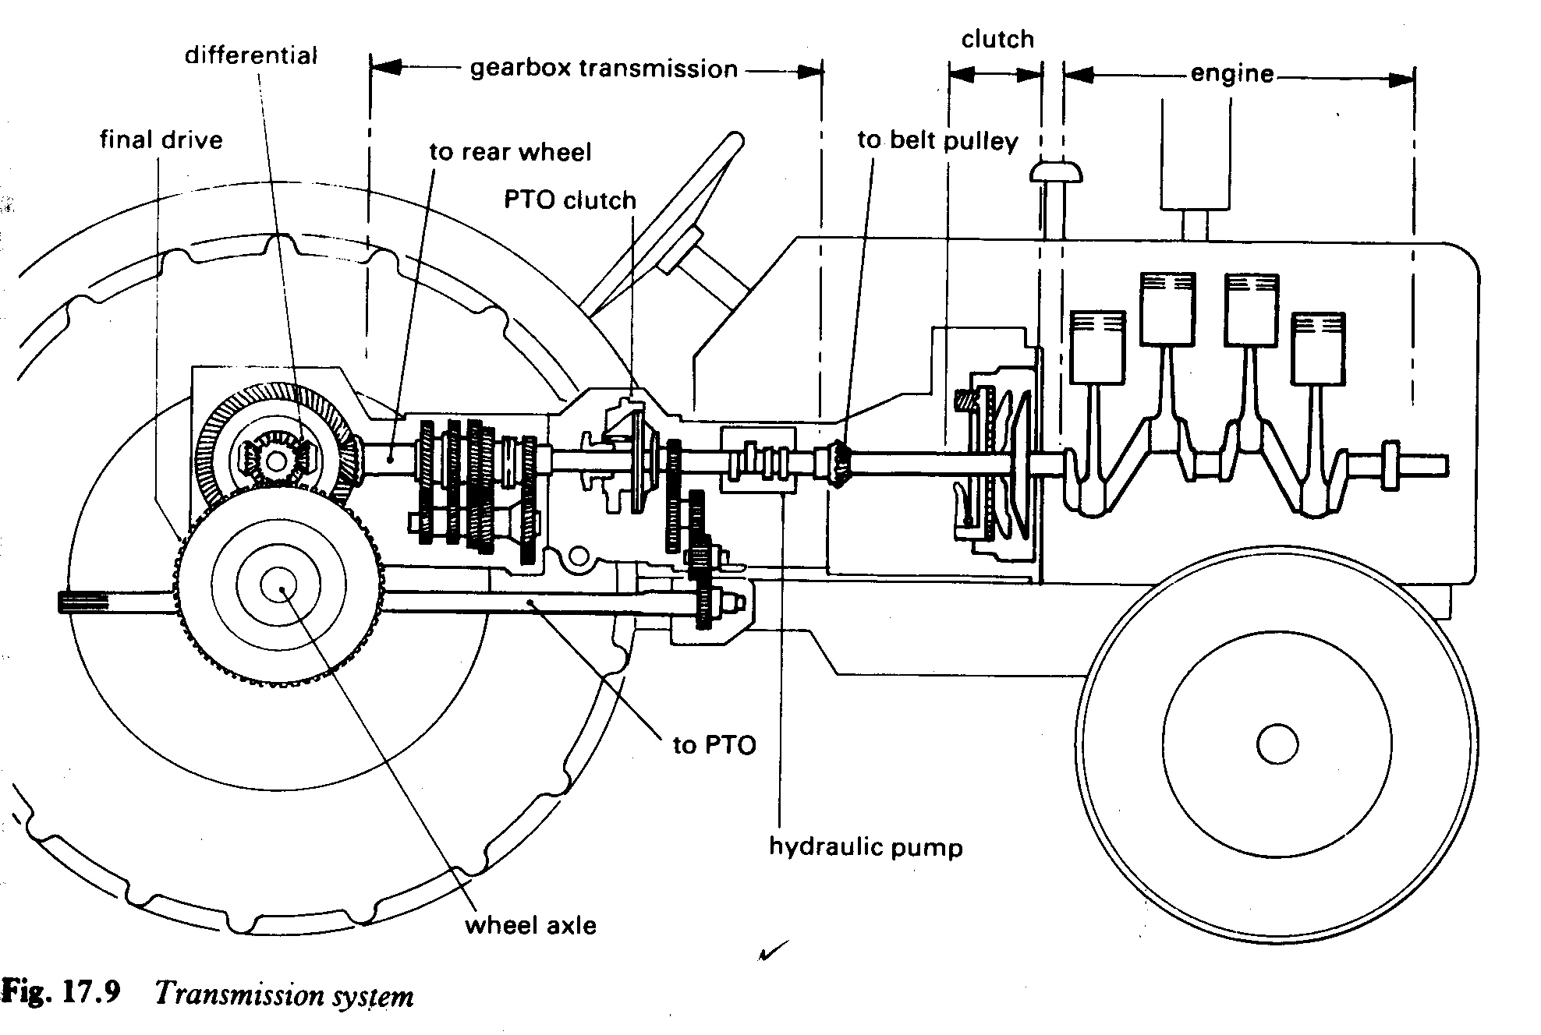
COMPONENTS OF THE TRANSMISSION SYSTEM

Slide 73
Functions of @ component
1. Clutch
It is a device used to connect or disconnect the source of power to the rest of the transmission system.
It consists of a disc called the clutch plate. The clutch plate is aligned on both sides with friction surfaces and drives other plates when they are in contact with it (engaged position).
During power transfer from the engine to the rest of the transmission system, the clutch plate is gripped between the face of the fly wheel and the pressure plate.
Power transfer is cut off when the clutch plate is disengaged from other plates by pressing the clutch pedal (foot pedal)
Main functions of the clutch
To connect and disconnect the engine from the rest of the transmission system when selecting a suitable gear for the farm operation going on and also when stopping the tractor.
Allows gradual transfer of engine power to the rear wheels so that the driver can take off smoothly.i.e helps the vehicle to take off gradually and smoothly.
Allows transfer of power from engine to P.T.O shaft
It helps the tractor to be stopped without stopping the engine.

Slide 74
2. Gear Box
It is a metallic box containing a range of gears with different diameters and numbers of teeth, which can be interlocked(meshed) by means of a gear lever to give different power out puts(pulling power) and speeds at the rear wheels.
The power produced by the engine can be multiplied by lowering the number of revolutions made by the wheels in relation to the number of revolutions made by the crankshaft.
The driven gear with the biggest diameter gives the lowest speed at the wheels but the highest power out put. It is used when taking off, going up hill and pulling heavy loads. It is usually referred to as gear one or low gear.
The driven gear with the smallest diameter gives the highest speed at the wheels but power out put is reduced. It is usually referred to as top gear or high gear and could be gear 4 or 5 depending on the tractor model.
Main functions of the gear box
To adjust the speed of the engine crankshaft to the speed at which the tractor is required to move when carrying out farm operations.

Slide 75
Cont’n
To allow the tractor to be moved in reverse direction whenever necessary.
To enable the operator adjust the pulling power output at the rear wheels to suit the farm operation being done.
It enables the driver to stop the movement of the tractor /vehicle without stopping/switching off the engine. This can be done by selection of the neutral gear.
Provides a number of gear ratios that enable the tractor to run at different speeds. Aslow speed (low gear) is convenient when taking off and when pulling loads, while faster speed (high gear) is convenient when running about on the farm.
3. Differential
It changes the direction of power through 90º so that it can be delivered to the rear wheels.
Power from the engine crankshaft is transmitted in one direction until it reaches the differential.
From the differential the direction of power transmission has to change because the axles which deliver power to the wheels are at right angles to the crankshaft.

Slide 76
It’s composed of a set of bevel gears. The larger gear is called the crown gear and the smaller one is called the bevel pinion.
It’s the gear set that changes the direction of power through 90º.It also makes it possible for the rear wheels to move at different speeds, thus enabling a tractor to turn /negotiate a corner.
When negotiating a corner, the wheel on the outside of the curve must travel farther and rotate faster than the inside wheel.
When it is so desired that both wheels should move in a straight line, a device called a differential lock is used. When the differential lock is engaged, it locks the differential unit so that the two half axles make one complete axle and both wheels move in a straight line and at exactly the same speed. Here the tractor cannot turn corners.
Functions of the differential
It changes the direction of power through 90º (right angles) so that power is transmitted to rear wheels.
It adjusts the speed of the drive further so that the operation works at a slower speed than the engine speed.
It enables each of the rear wheels to travel at a different speed when turning a corner

Slide 77
Wheels and tyres
Rear wheels are the final component of the transmission system. They receive power from the engine via the differential. Wheels have tyres for grip and they functionally propel the machine forward or back wards as required by the operator.
The front wheels on the tractor are mainly used for steering, while rear wheels provide grip or traction.
Functions of the Wheels and tyres
They enable the tractor to move forward or backward so that it can do useful work.
Tyres allow maximum possible grip (traction) because they have a large surface area.
Ways of improving traction of tyres
Traction is the power used in pulling loads or objects over a surface.
Improving/increasing traction is the increasing of grip (contact) of tyres on the ground surface for better friction so that the tractor moves evenly

Slide 78
Ways of improving traction include:
Ballasting the tyres: water is pumped into the tube of the tyre through a special valve that lets the water in as it allows air to escape.
Use of metallic wheels: this increases grip mostly especially in muddy/slippery areas, however, they are not recommended on public roads.
Twining of tyres (use double tyres) adding more wheels on the rear axle.
Adding weights to the rear and front wheels: these are made of cast iron and help to increase stability by lowering the centre of gravity as the tractor moves.
Reducing tyre pressure: this increases the surface area of contact on the ground (grip), but it should not be done up to the point where the tyre sides are seen to ripple as the tractor moves.
Using 4-wheel drive.
using flat tyres with high grip
Using tyres with big treads hence the treads should not worn out.

Slide 79
Power take – off (PTO) shaft
The PTO shaft is an extension of the lay shaft found in the gear box. It serves as a power outlet from the tractor for operating machines and implements pulled behind the tractor .e.g mowers, planters, rotary cultivators, pumps, and threshers.
Tractors are equipped with a separate clutch for engaging and disengaging the PTO shaft without interfering with the movement of the tractor.
When the PTO shaft is not in use it should be covered with the PTO shield or guard so as to avoid causing accidents.
Other transmission accessories include breaks, belt pullies, hydraulic system, and these works together with the system.
Breaks
These are basically safety features although on a tractor they can be used for turning a wheel but the most common types are; disc breaks; breaks on a tractor operate independently of each wheel.

Slide 80
Tractor tyres and wheels
Important features of the rear tyres.
They are generally larger and wider in diameter.
Bars on tyres are arranged in a V pattern to improve grip and self cleaning property.
Important features of front tyres
They are generally narrow and smaller in diameter
The tyres are thin.
They have a continuous band of rubber around the tyre to be able to support the weight.
Problems of under inflation (low pressure)
Damages the body of the tyre.
It tends to crack on the tyre wall.
reduces the tractor speed
wastes fuel
Qn. (a) Explain the factors that affect the life span of tractor tyres.(
(b) How can the traction of tyres be increased?

Slide 81
MAINTENANCE OF THE TRANSMISSION SYSTEM
The right type and quantity of lubricating oil must be used in the transmission system.
The oil should be changed at specified time intervals as recommended by the manufacturer.
Tyres must be inflated to the pressures recommended by the manufacturer.
Tyres must be checked regularly for cuts and bulges to avoid tyre explosion that may result in accidents.
Old tyres with little or no treads should be replaced because they reduce the tractor’s pull performance.
Qn. Giving practical details, describe how you would maintain a farm tractor in good working condition.

Slide 82
TILLAGE EQUIPMENTS
Mechanical manipulation of soil to provide favourable condition for proper crop
growth is called tillage. Soil tillage consists of breaking the compact surface of earth to a
certain depth and to loosen the soil mass so as to enable the roots of the crops to
penetrate and spread into the soil
Tillage equipments(implements) are classified into primary and secondary tillage equipments on the basis of tillage operations for which the equipment is used.
PRIMARY TILLAGE EQUIPMENTS
These are implements, which are used to open up land in the initial stages of preparations for planting.
These are usually heavy machines &are used for deep cultivation.
They include;
Disc plough
Mould board plough
Chisel ploughs
Sub-soilers
Rotary cultivators

Slide 83
Disc plough
It consists of a number of discs mounted on the beam by disc hangers.
Notched discs are sometimes preferred because they are light.
Disc ploughs are heavily built to enable them penetrate the ground by their weight.
ADVANTAGES OF DISC PLOUGHS
Rides over obstacles
Can be used in dry and very hard soils
Works well in both heavy, light and sticky soils
Requires low maintenance costs
Quicker in operation

Slide 84
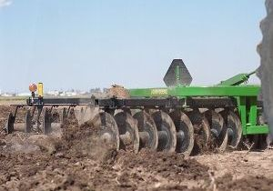
Structure of a disc plough

Slide 85
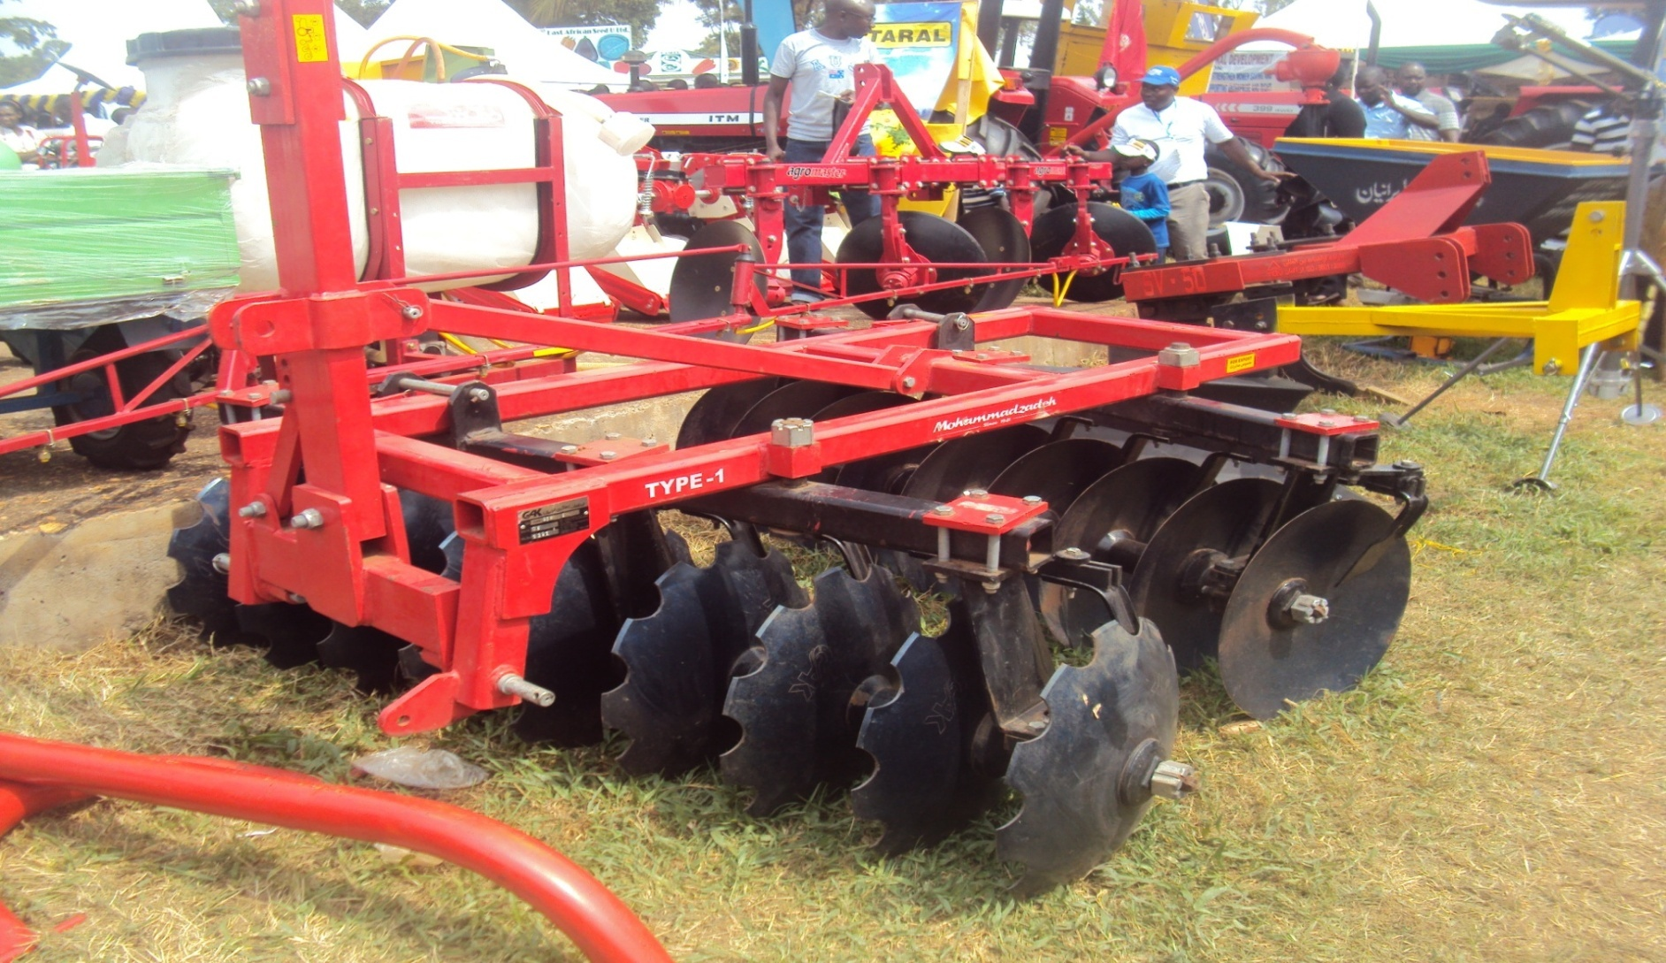
An advanced disc plough with both the whole & dragged discs

Slide 86
Chisel plough
This is an implement with sturdy and strong tines arranged on heavy frames in two or three staggered rows.
It is a heavy duty cultivator in that the sharply sharpened chisels are penetrate deep layers of both hard and marshy soils.
It requires considerable power to pull it because of its heavy construction.
It is therefore tractor drawn although animal drawn models are available.

Slide 87
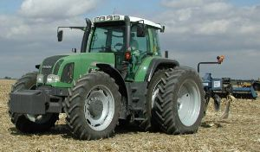
Structure of a chisel plough

Slide 88
Secondary tillage equipment
Secondary tillage means stirring the soil at a comparatively shallow depths .
Secondary tillage operations follows the deeper primary operations.
Tillage equipments used in these operation include
Harrows;-disc harrows , chain harrows, zigzag harrows , seed harrows and spike tooth harrows, spring tooth drag harrow
Cultivators;-, rigid-tine cultivator , spring –tine cultivator
Ridgers
Rotovators
Clumbler roller

Slide 89
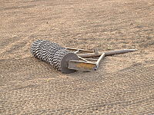
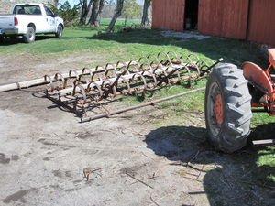
STRUCTURES OF CLUMBLER ROLLER AND SPRING TOOTH DRAG HARROW
A

Slide 90
PLANTING EQUIPMENTS
These are any power operated devices or machines used to place seed pieces or plant parts in or on soil for propagation and production of food , fiber and feed crops.
They are designed depending on the type of planting materials they are used for.
They plant crops at the right spacing and depth previously set.
Classification of planting equipments
There are three types of planting equipments;
Broad casters
Seed drills (seeders)
planters

Slide 91
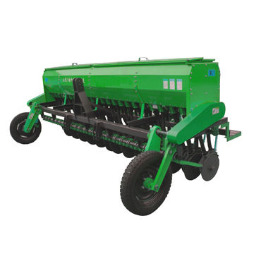
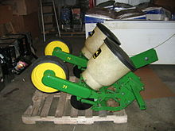
Categories of planters

Slide 92
The seeding unit can seed exactly, the rate of quantity of seeding seeds can reach more than 80%It can seed in a high speed, the speed of seeding can reach 8 km/h when the planting spacing less than 20cm
.Accurately seeding planting spacing, even seeding, reduce the competition of the seeding growing, the growing of the seeding in better and the output of the crop in high
The two kinds of seeder unit can be used on the seeder, the one is for single seed, other one is for double seeds, when your seeds is better, you may chose the seeder with seeder unit of single seeds for seeding in precision (one hole one seeds) If the seeds is general seeds, you may chose the seeder with seeder unit of double seeds (one hole two seeds)

Slide 93
The transmission axles of each row are contacted as a whole, driving with consistent turn speed The transmitting power is strong, even though one of the rows’ ground wheel slips suddenly, which can not affect the normal sowing
The seeders’ planting spacing of the whole seeder can be changed by a gearbox, which can provide four kinds of rows spacing The whole seeders’ planting spacing of each row can be changed as long as changing the transmission ratio of gearbox
All the gears in gearbox are made of the best steel carburized, all the transmission components were put to use the quality of rolling bearing, reliable performance

Slide 94
Key Specifications / Special Features:
Suitable for sowing in drill, including barley, millet, sorghum, grass, sesame and more
. They can fertilize while drilling, fertilizing, covering, rolling, during one operation
They are safe, durable, high efficiency, they can level the surface after drilling
Model | 2BFX-16 | 2BFX-18 | 2BFX-24 | 2BX-24
Width of sowing width (mm) | 240 | 270 | 360 | 360
Rows | 16 | 18 | 24 | 24
 | 40-80 | 40-80 | 40-80 | 40-80
Capacity of seeder tank (L) | 245 | 286 | 410 | 60

Slide 95
CROP & ANIMAL PROTECTION EQUIPMENTS
In agricultural production, there is need to protect crops and animals against pests and diseases using chemicals .
The farmer will use sprayers and dusters in applying chemicals in liquid form.
Such chemicals include; insecticide, pesticides , fungicides, herbicides and acaricides.
Equipments used in these operations include;
Sprayers such as plantector, hand operated, pressurized /pneumatic sprayers , motorized(engine driven) knapsack sprayers
Dusters such as hand bellow dusters, ground driven dusters, tractor power take off duster , engine dusters , air craft dusters

Slide 96
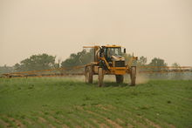
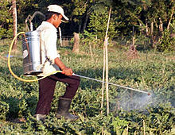
CROP PROTECTION EQUIPMENTS A SELF PROPELLED ROW CROP SPRAYER & A manual backpack-type sprayer

Slide 97
HARVESTING EQUIPMENTS
These equipments are designed to handle specific crop because different crops are handled differently.
Some crops are harvested above the ground e.g cereals
Others are harvested below the ground such include ground nuts, cassava, potatoes , yams among others.
Fruits ,forage and vegetables shall require specialize harvesting equipments
The use of harvesting machines in developing countries is still limited due;
To small farm sizes owned by farmers
. The nature of farming patterns
Level of out put
Level of technology e.t.c.

Slide 98
Types of harvesting equipments
Harvesting equipments include
Forage harvesting equipments-for cutting green succulent material into silos.
Hay harvesting equipment- involved in the various types of dry hay-making such as mowers , rakes, balers , loaders , stackers and hey-handling equipments
Combine harvesters- these are designed to harvest grain crops (grain harvesting equipments) they have threshers
They are usually sophisticated and costly machines that require technical knowledge to operate and maintain.

Slide 99
THE COMBINE HARVESTER
These are usually used in areas where large scale farming is practiced.
Its main advantage is that it can do various jobs in a single operation. i.e. cutting, threshing, winnowing, cleaning and bagging.
Components of Combine Harvester
The cutter bar equipped with knives
A threshing mechanism (threshing unit)
A winnowing mechanism (a cleaning and separating unit)
A mechanism for elevating the clean seeds to the tank
The grading mechanism- sorting grain according to size and packing/ bagging

Slide 100
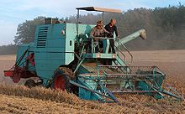
The combine harvester

Slide 101
CARE AND MAINTENANCE OF A COMBINE HARVESTER
Tighten all loose nuts and bolts before starting a day’s work
Check the systems, belts and chains if the machine has a separate engine e.g. cooling, lubrication ,fuel supply and the air cleaning system.
Replace all faulty parts in the above systems
Remove any foreign material that may stuck in some parts of the combine

Slide 102
Thank you for listening

